Slide 1
Using Destiny Discover
A step-by-step guide
Logging into Destiny
Browsing Destiny
Searching Destiny
Checking out an eBook or audiobook

Slide 2
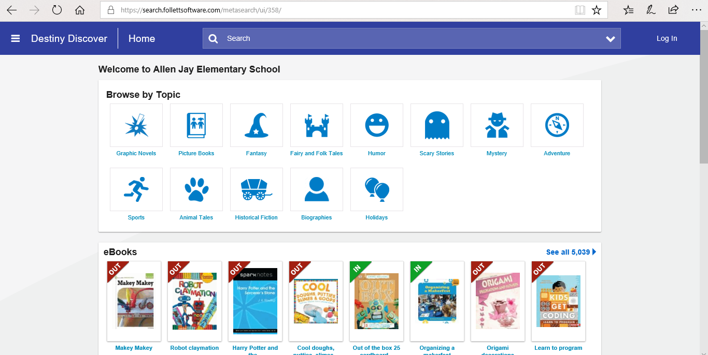
LOGGING INTO THE SITE Our Online Catalog can be reached by clicking HERE
Log into the site by clicking here and entering your student’s ID as the username and their birthday as the password.

Slide 3
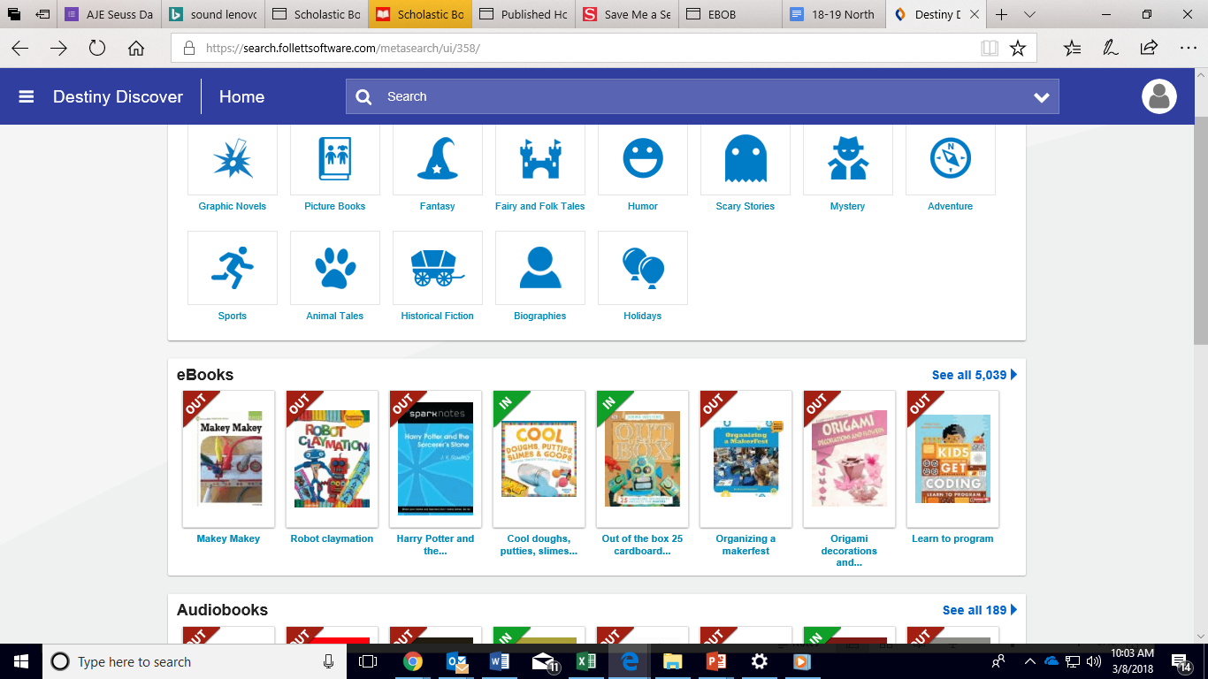
Browsing Destiny
Use the picture categories to browse for groups of books dealing with a particular subject.
Browse the most popular eBooks & audiobooks.

Slide 4
Searching Destiny
If you are looking for something specific, you can use the bar to perform a search.

Slide 5
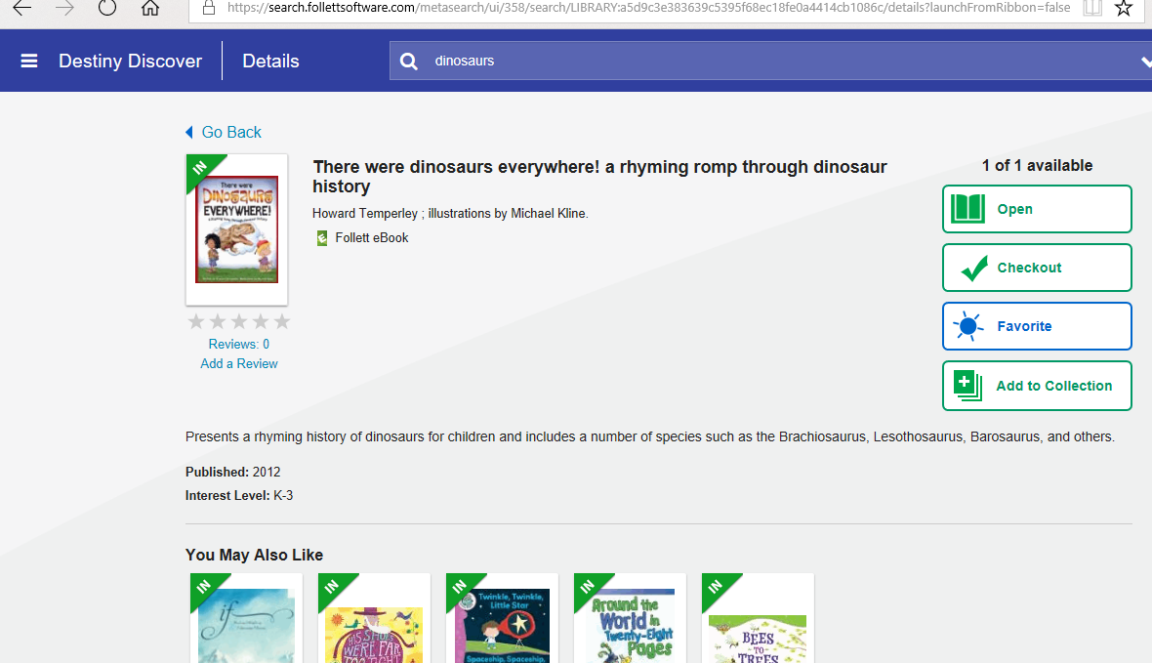
Checking Out Online
After clicking on your eBook or audiobook, you can choose to either Open or Checkout. Checkouts will appear in your bookbag at the top left of the screen.
First, click on the picture of the eBook you want to read.

Slide 6
Please Remember
This tutorial only covers the most basic functions of our Online Catalog.
I am always available should you have any questions or need further assistance.
My email is barrilr@gcsnc.com

